Slide 1

Data Visualization on COVID-19 day to day analysis and prediction
Project Supervisor: Dr. Joshila Grace
Name of the Student: Mr. Kolla Om Vivek
Register Number: 39110511

Slide 2
Presentation Outline
Course Certificate
Introduction
Objectives
System Architecture
Module Implementation
Project Implementation
Results and Discussions
Conclusion
References

Slide 3
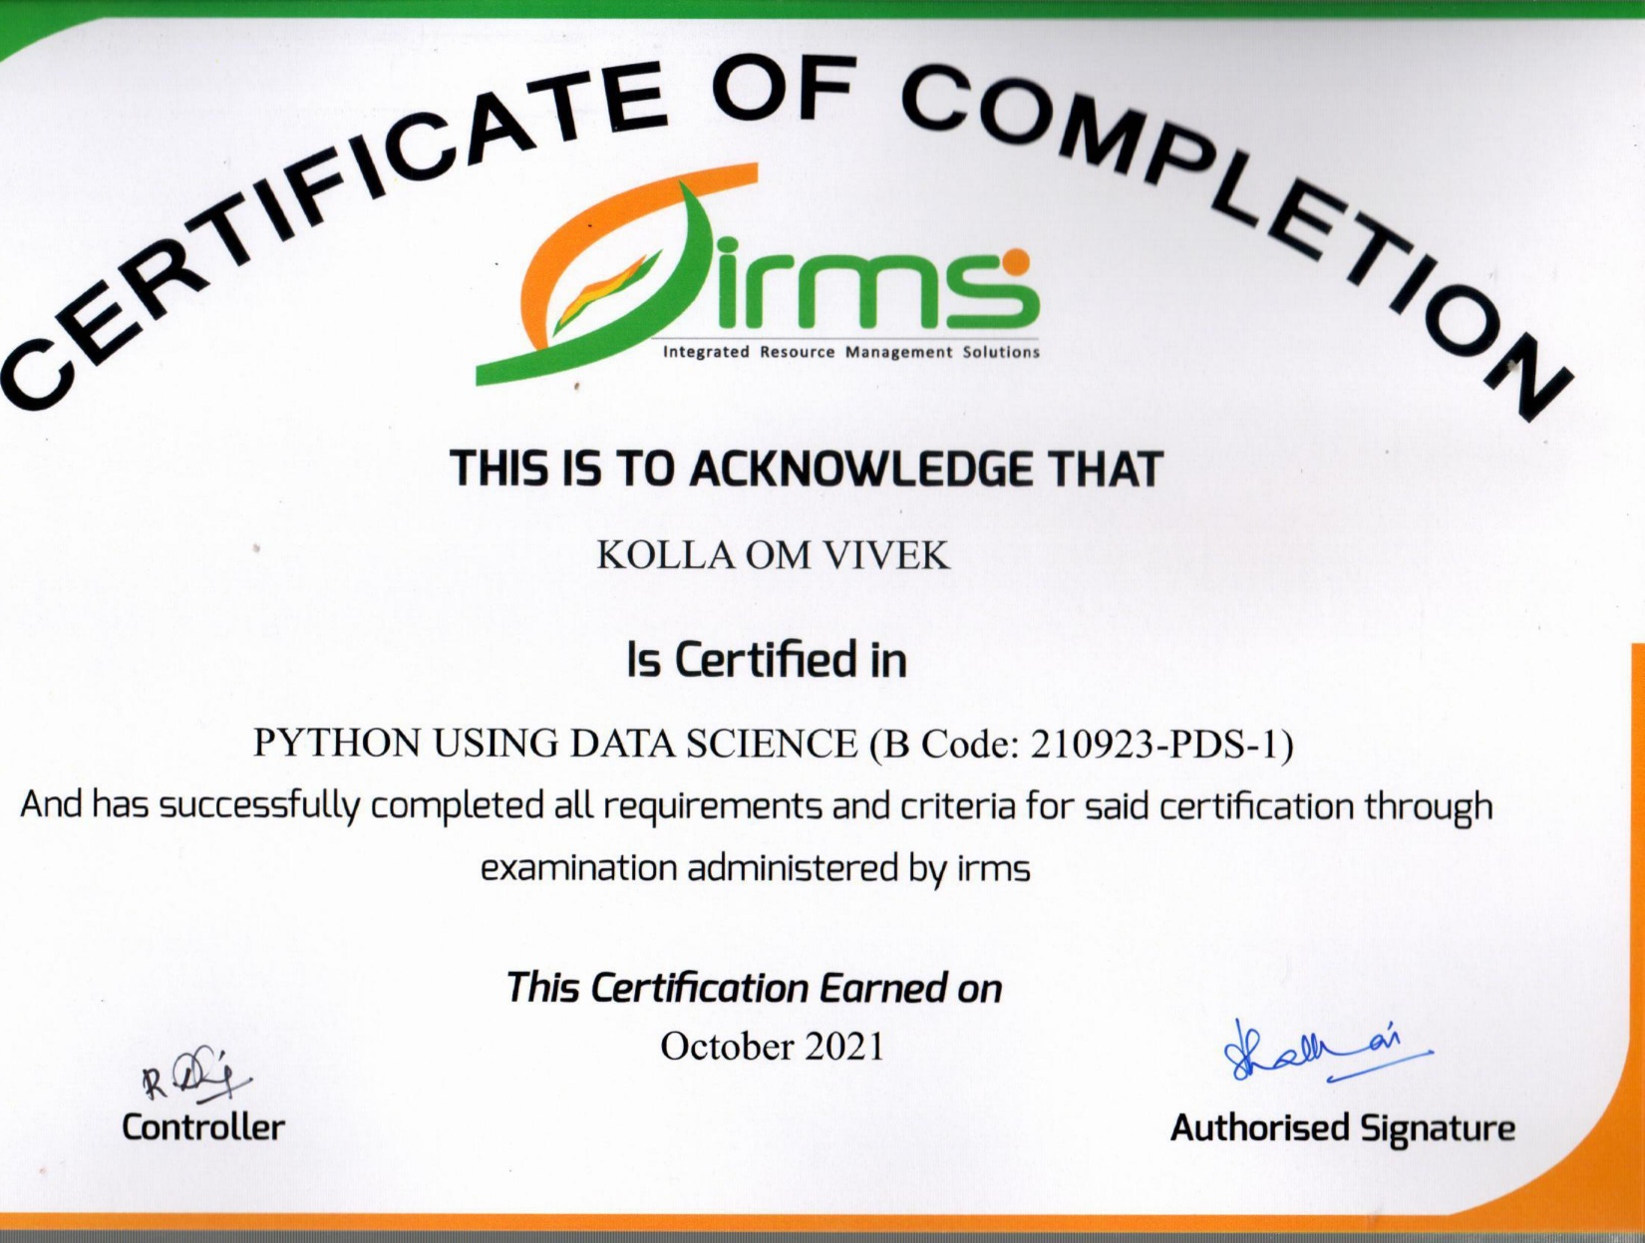
Course Certificate

Slide 4
Introduction
Corona virus identified in 2019 ,SARS-CoV-2. This virus was firstly identified in People’s Pepublic Of China in Wuhan.
Data Science for COVID-19 presents leading-edge research on data science techniques for the detection, treatment and elimination of COVID-19.
During the current coronavirus pandemic, monitoring the evolution of COVID-19 cases is of utmost importance for the authorities to make informed policy decisions (e.g., lock-downs), and to raise awareness in the general public for taking appropriate public health measures.

Slide 5
Introduction
Data Visualization gives us a clear idea of what is the information, means by giving it visual context through graphs.
This makes the data more natural for the human mind to comprehend and therefore makes it easier to identify trends, patterns and outliers within large data sets.
At the end, we can analyze the data by using the graphs , bar plots, etc., and get some useful insights from the data.

Slide 6
Objectives
Objective of the project :
Main goal is to express data in easier way so that everyone can understand
Visualizing the data of covid-19 of all the country's around the world and all the state’s of India
Scope of the project :
To get some useful data about Covid-19 like Case’s, Deaths and Conformed case’s
We are going to achieve the objective by performing various processes like cleaning and analyzing the data by using various plotting tools like matplotlib, plotly , seaborn .

Slide 7
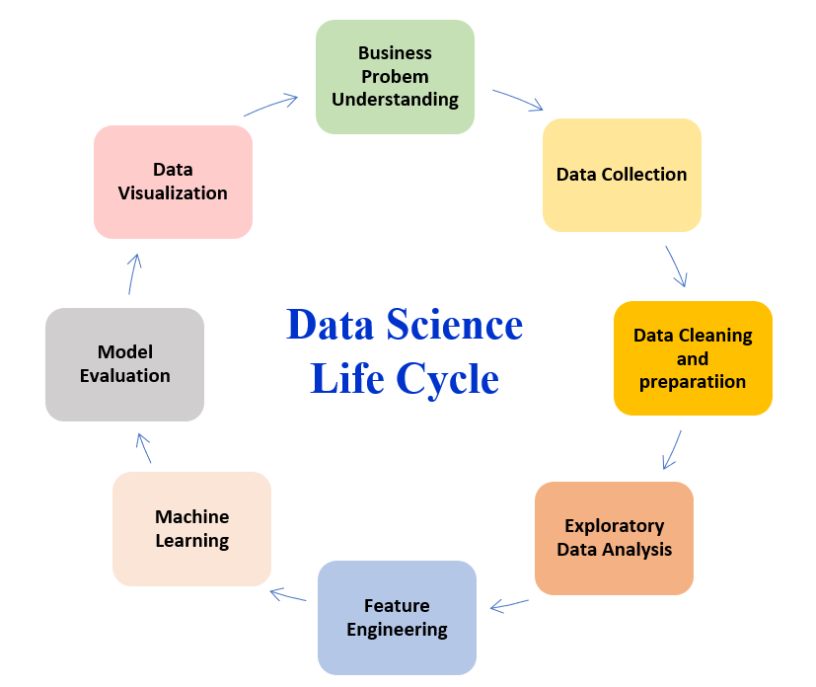
System Architecture

Slide 8
Module Implementation
This Module contains mainly 3 parts:
Datasets(Covid-19) are csv file’s which contains the raw data.
We used plotly library to visualize the data, which is an open-source and we use pywebio library for web-application and it is mostly used by data scientists for data visualization.
The plots are plotted after the data is processed and the data is ready for the analysis.

Slide 9
Project Implementation
Modules.
Hardware and Software Requirements.
Construction.
Measurement and Analysis.
Methodology.

Slide 10
Modules
Pandas :
pandas is a Python library for data analysis .
Pandas is built on top of two core Python libraries
matplotlib for data visualization
NumPy for mathematical operations.
Pandas acts as a wrapper over these libraries, allowing you to access many of matplotlib's and NumPy's methods with less code.

Slide 11
Modules
Numpy :
NumPy is a Python library used for working with arrays.
In Python we have lists that serve the purpose of arrays, but they are slow to process.
NumPy aims to provide an array object that is up to 50x faster than traditional Python lists.
The array object in NumPy is called ndarray , it provides a lot of supporting functions that make working with ndarray very easy.
Arrays are very frequently used in data science, where speed and resources are very important.

Slide 12
Modules
Regular Expressions :
A Regular Expressions (RegEx) is a special sequence of characters that uses a search pattern to find a string or set of strings
It can detect the presence or absence of a text by matching with a particular pattern, and also can split a pattern into one or more sub-patterns.
Python provides a re module that supports the use of regex in Python.
Its primary function is to offer a search, where it takes a regular expression and a string.

Slide 13
Modules
Time :
The Python time module provides many ways of representing time in code, such as objects, numbers, and strings
It also provides functionality other than representing time
like waiting during code execution and measuring the efficiency of your code.

Slide 14
Modules
Matplotlib :
Matplotlib is an amazing visualization library in Python for 2D plots of arrays
Matplotlib is a multi-platform data visualization library built on NumPy arrays
One of the greatest benefits of visualization is that it allows us visual access to huge amounts of data in easily digestible visuals.
Matplotlib consists of several plots like line, bar, scatter, histogram etc.

Slide 15
Modules
Pywebio :
PyWebIO provides a diverse set of imperative functions to obtain user input and output content on the browser, turning the browser into a “rich text terminal”, and can be used to build simple web applications or browser-based GUI applications.

Slide 16
Modules
Pygame :
The pygame library is an open-source module for the Python programming language specifically intended to help you make games and other multimedia applications.
Built on top of the highly portable SDL (Simple DirectMedia Layer) development library, pygame can run across many platforms and operating systems.

Slide 17
Modules
Plotly :
The plotly Python library is an interactive, open-source plotting library that supports over 40 unique chart types covering a wide range of statistical, financial, geographic, scientific, and 3-dimensional use-cases.

Slide 18
Hardware and Software Requirements
Hardware:
Desktop , Keyboard , Mouse , Screen , Hard Drive , GPU , CPU and RAM
Software:
System requirements for Python Installation:
Operating system: Linux- Ubuntu 16.04 to 17.10, or Windows 7 to 10, with 2GB RAM (4GB preferable)
You have to install Python 3.6 and related packages
Jupyter Notebook , IDLE , Atom

Slide 19
Construction
I’m taken two dataset’s. one set is to represent all country’s data and another one is to represent the data of states of India .
After collecting the data set’s from the website, By using numpy and pandas I converted data in the way that we can able to see the resultant graph’s .
By using matplotlib,plotly and seaborn libraries we represent the data into graph’s
At the end by using pywebio we’re going to create a front-end for a better experience .

Slide 20
Measurement and Analysis
From the graph’s they can able to analyze the new case’s, deaths and conformed cases .
For all the countries and all the states of India .

Slide 21
Methodology
Methodology of Data Visualization on Covid19 Dataset :
Step 1: Import the needed modules.
Step 2: Get your dataset and read it.
Step 3: using numpy and pandas clean the data
Step 4:Once the data is clean now we are good to go with the visualization part.
Step 5: Start visualizing the data by considering different columns.

Slide 22
Methodology
Step 6: Plot the graphs with the help of data and modules imported
Step 7: Generating the results in the pywebio application
Step 8: Once visualizing the data is completed start analyzing the data.
Step 9: predicting tomorrow’s Covid-19 cases.

Slide 23
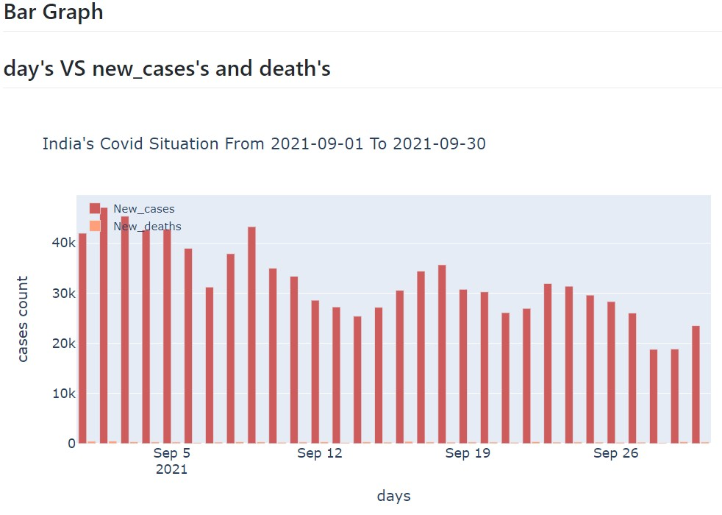
Results and Discussion

Slide 24
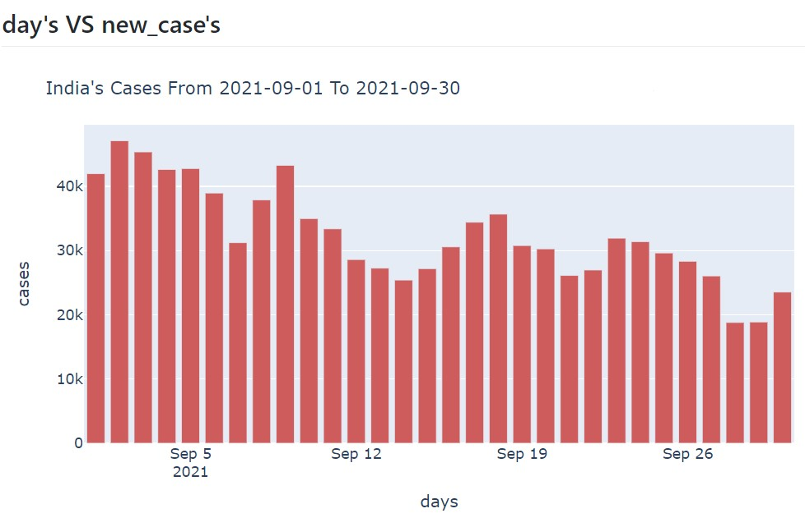

Slide 25
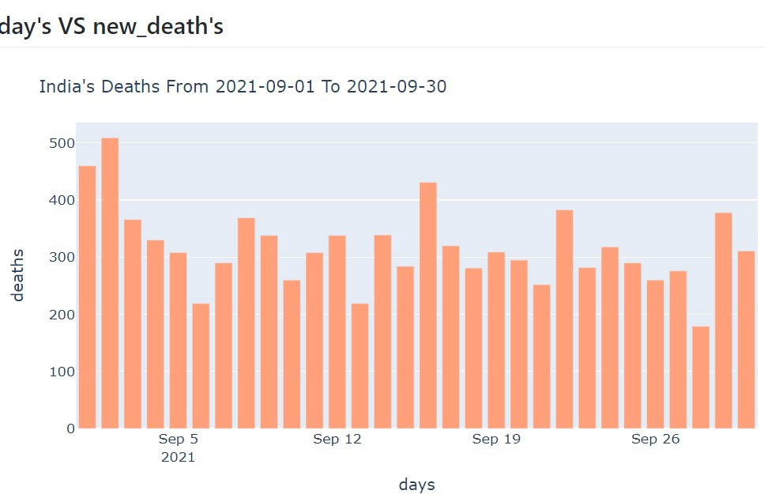

Slide 26
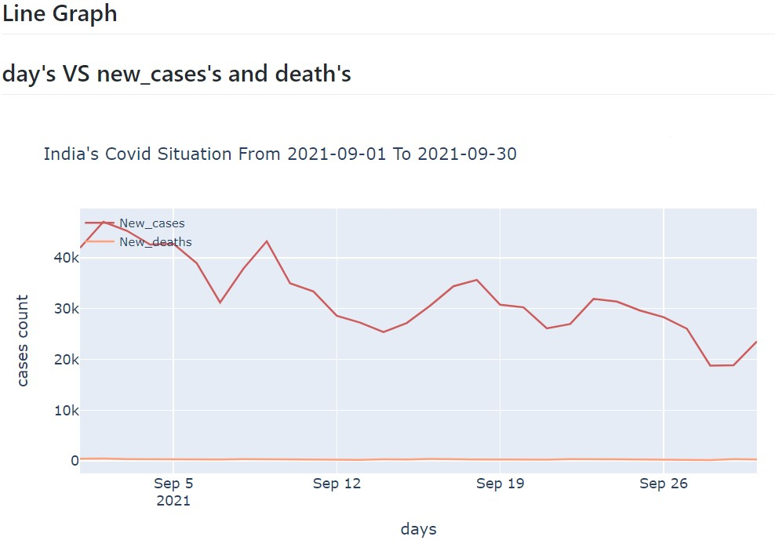

Slide 27
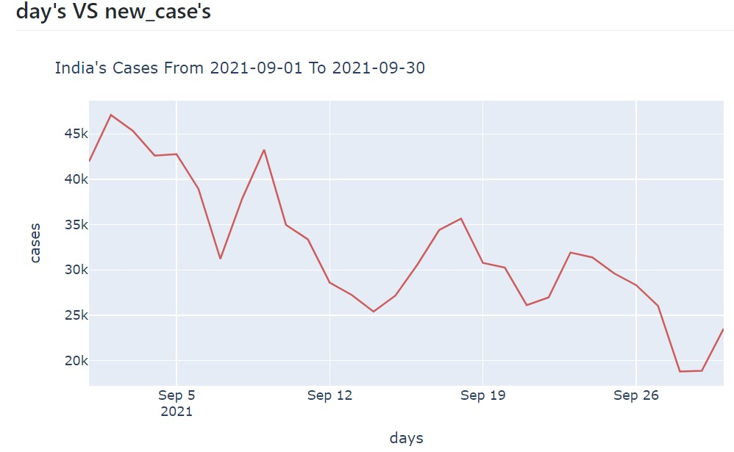

Slide 28
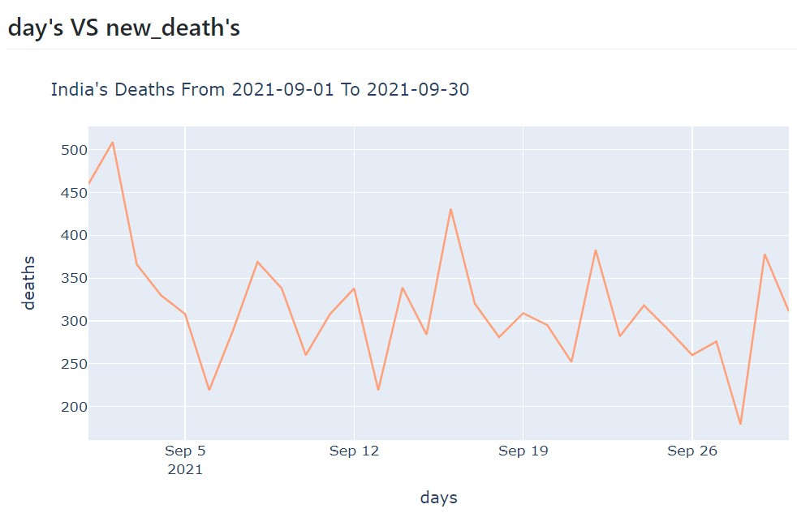

Slide 29
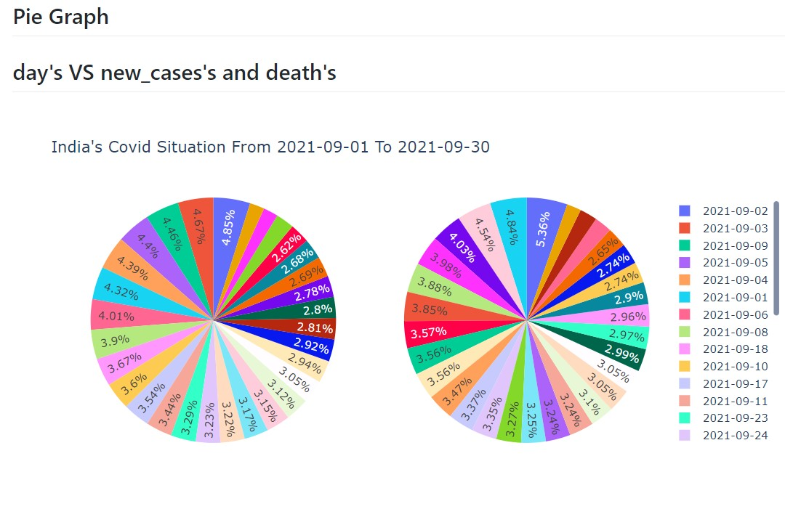

Slide 30
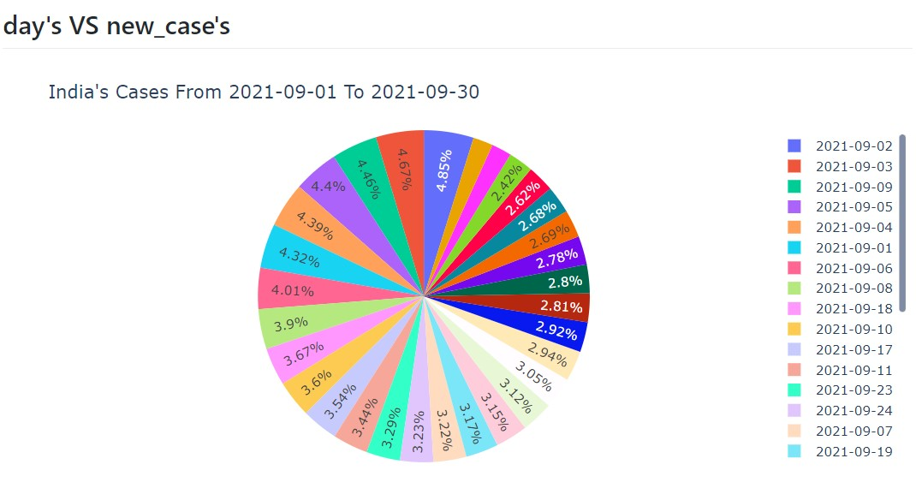

Slide 31
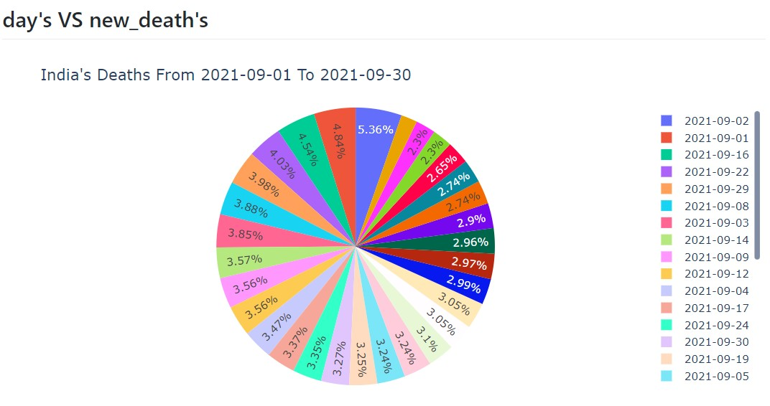

Slide 32
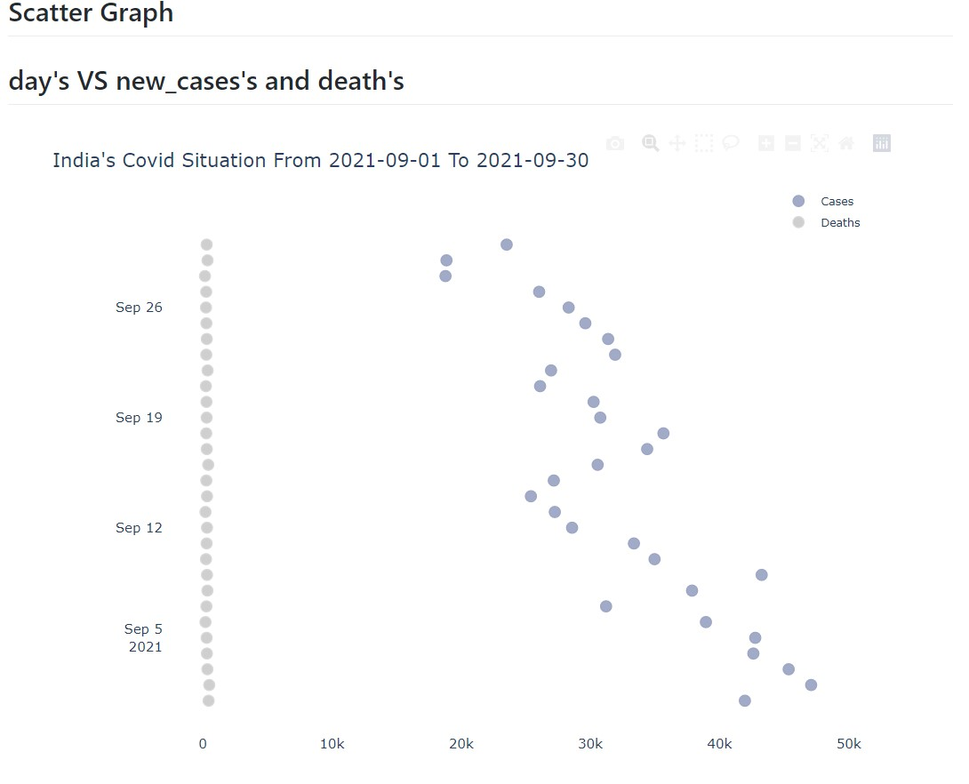

Slide 33
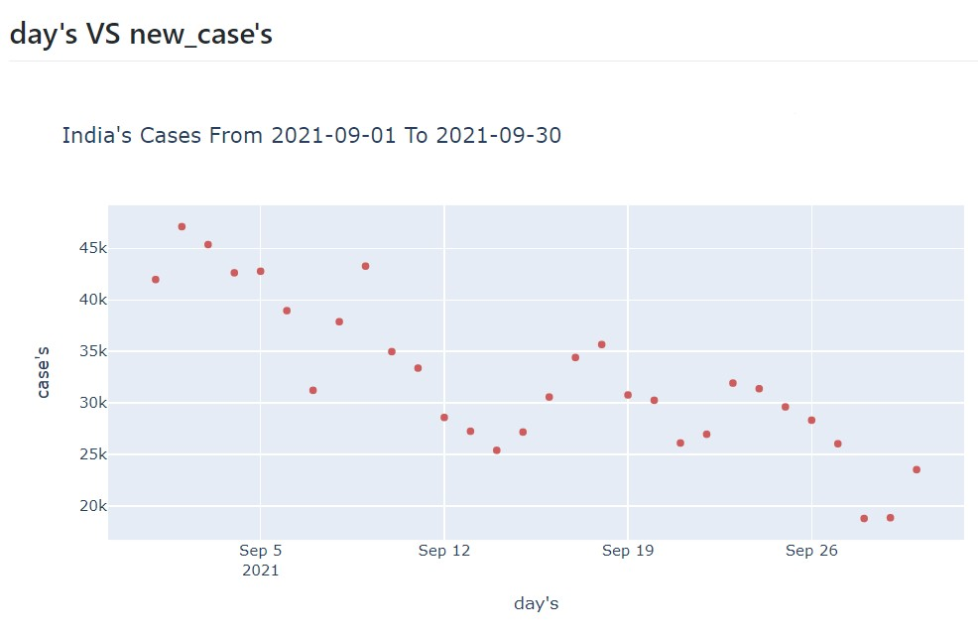

Slide 34
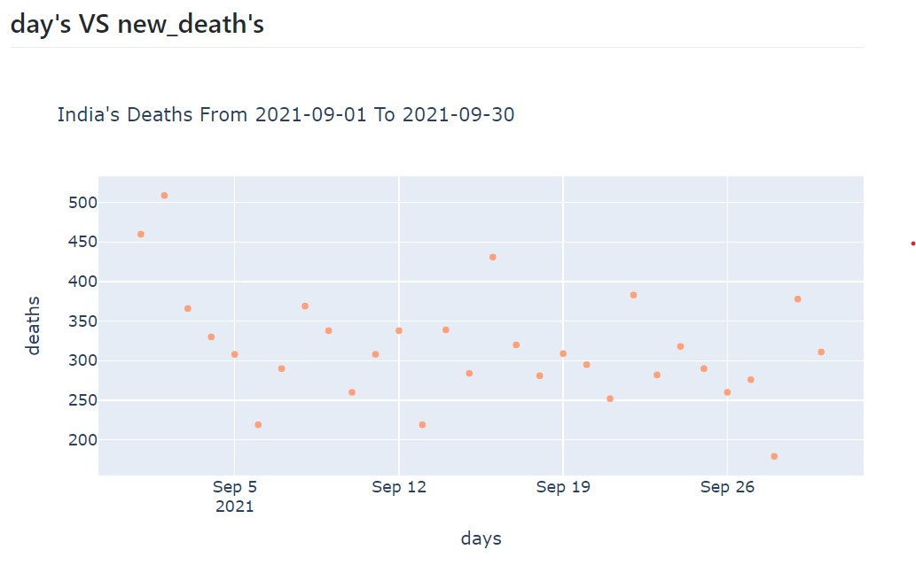

Slide 35
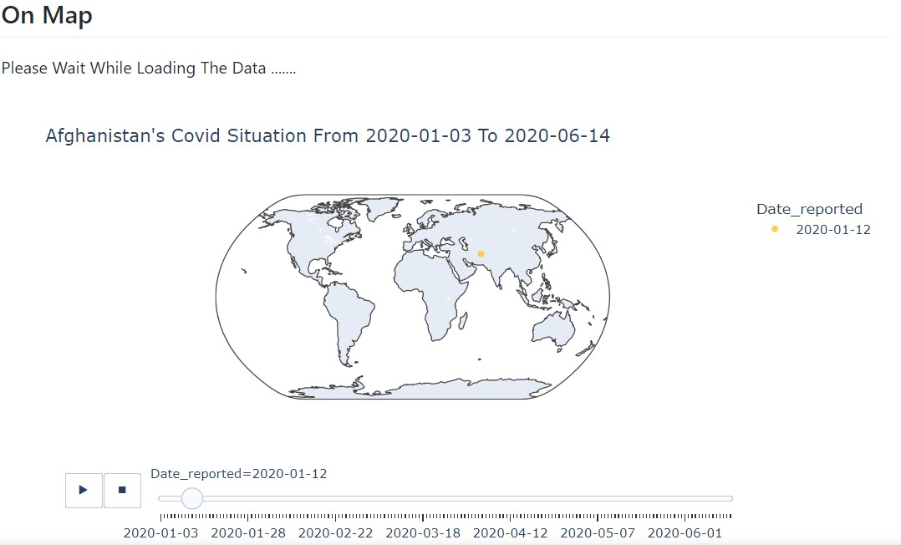

Slide 36
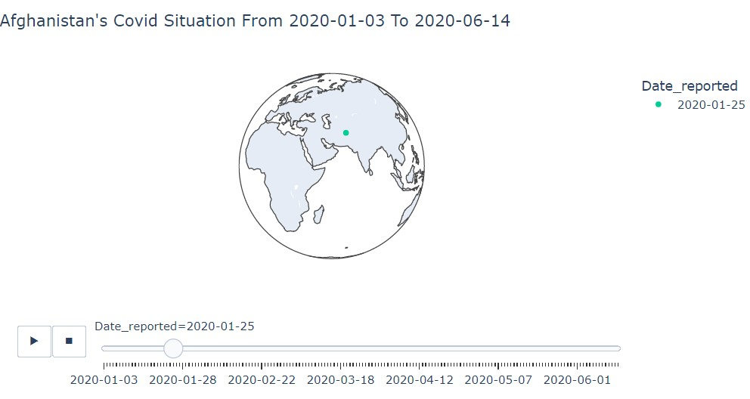

Slide 37
Conclusion
They can able to know the statistics on Covid-19 pandemic of all the country’s and all the states of India.
Result is going to be always in graph’s. so, they can understand the situation very easily and able to take precautions.
my graphical estimations require large amounts of data from active participants, but provide insightful depictions of the progress of the pandemic in different regions, offering an estimation of active number of cases and deaths in different geographical areas.

Slide 38
References
[1] | Dataset Country’s around the world - https://covid19.who.int All the states of India - https://www.kaggle.com/sudalairajkumar/covid19-in-india
[2] | Data processing Numpy - https://www.w3schools.com/python/numpy/numpy_intro.asp Pandas - https://www.w3schools.com/python/pandas/default.asp Data validation https://www.w3schools.com/python/python_regex.asp
[3] | Data visualization Matplotlib - https://www.w3schools.com/python/matplotlib_pyplot.asp
[4] | Web application Pywebio - https://www.pyweb.io/tutorial.html

